Slide 1


6.1 Assignment PowerPoint
Jeanette A. Fuller
Notes:
Welcome to my 6.1 Assignment PowerPoint presentation. I am your narrator, Jeanette Fuller. Thank you for attending my presentation today.

Slide 2
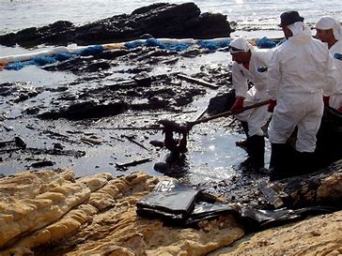
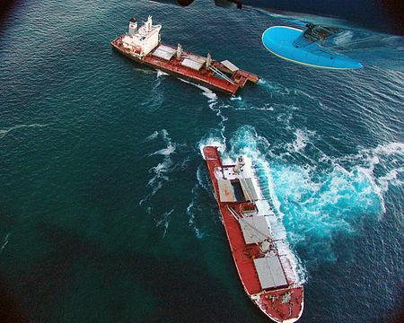
Agenda
Introduction
Part One: Overview of the Team
Part Two: Topic Slides
Conclusion
Notes:
Today’s agenda includes my brief introduction to the Selandang Ayu, the overview of the team, topic slides dealing with the conflict I encountered and a conclusion.

Slide 3
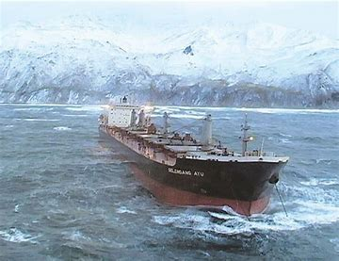
Introduction
Selandang Ayu Oil Spill
Malaysian cargo vessel
Ran aground and broke apart in Skan Bay, Alaska in December 2004
Spilled nearly one million gallons of oil and diesel onto the shorelines of Skan Bay and nearby Mushin Bay, Alaska
Pacific Environmental (PEC) was one of several companies contracted to clean up the oil.
Provided two full teams of technicians and skiff operators to clean oil from contaminated shorelines from April to September 2005
Crews lived and worked 24/7 aboard the fishing vessel, Alaskan Lady, for approximately four months
Full crews had to work on shore every day or face significant fines per person absent
Notes:
In 2004, I was assigned as a foreman on a six- person team of oil spill clean up technicians dispatched out into the remote wilds of Dutch Harbor, Alaska. This was my first assignment as a supervisor outside of the military. It was also one of the most physically and mentally difficult jobs I have ever held.
While our teams were well outfitted with gear and equipment to do the work, the foremen and supervisor were not prepared for the conflicts that arose around reward systems, personalities, perceptions, employee attitudes, motivational needs, stress and conflict or team dynamics.

Slide 4
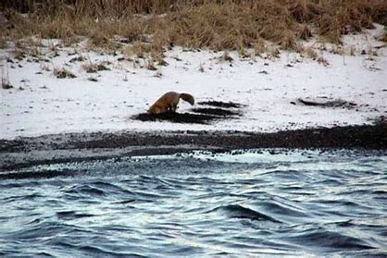
Part I: Overview of the Team
Roles and Responsibilities
Vessel Crew
  Maintained absolute authority over everyone on the vessel
Supervisor
  Oversaw foremen and safety officer
  Reported directly to PEC senior management, ADEC and the captain of the vessel
Safety Officer
  Conducted daily safety briefings and ensured all health and safety rules followed and personal protective gear supplied to crews
  Reported directly to supervisor and safety officer of ADEC
Foremen
  Reported directly to Supervisor and to ADEC field agents
  Oversaw two teams of seven and six oil spill technicians & all oil spill operations on land
Skiff Operators
  Maintained, repaired, launched skiffs used to transport technicians and equipment to and from the affected beaches
  Report to captain and supervisor
  Maintain absolute authority over crews while transporting them from vessel to job site
Oil Spill Clean Up Technicians
  Clean up oil from affected beaches
  Report directly to foremen on land, to skiff operators in transit and to captain while on board vessel
Notes:
The teams consisted of vessel crew, a supervisor, a safety officer, 2 foremen, 2 skiff operators, and 13 oil spill technicians divided into 2 teams of six and seven technicians. The chain of command was rather complex with multiple levels of supervision required to interact with multiple levels of management. The captain held ultimate authority over all crew members aboard his vessel. This vast network of command led to a general state of confusion and leaders at all levels tended to freeze up and defer decision making to the next level. As you can imagine, this led to many unresolved conflicts.

Slide 5
Part I: Overview of the Team
Weaknesses
Strengths
Crews used to incentivized pay rates (pay per unit); not a standard flat rate
Diverse cultures and personalities
Members used to authoritarian style management situations
Complicated chain of command (many bosses)
Lack of defined roles
Lack of opportunity to move around from job to job
No days off
Extreme environmental stress/chronic cold weather skeletal muscular injuries
Extremely limited contact with the outside world for 28 days
Living and working in extremely close quarters
Vulnerable to groupthink and malaise and sometimes mutiny
Crews changed out every 28 days
Use to working in harsh environments
Diverse cultures and work backgrounds
Members attuned to taking orders quickly without questions
High degree of resiliency
Crews enjoyed friendly games of competition on the beach
Crews eager to cross train even if there was no monetary recognition – highly adaptable
Crews became very close
Crews found creative ways to alleviate boredom and stress
Skiff operators used to remote work and helped technicians cope
Competition with other spill cleanup crews created strong group identity
Group tended to blend very well
Notes:
The work crews were comprised mainly of asbestos abatement technicians and fishermen who worked under incentivized pay systems. They were uncomfortable working under a standard, flat rate. They were used to working in fast paced, pay per unit work environments and had a very tough time adjusting to the slow drudgery of oil spill clean up. Our crews consisted of non-native and native Alaskan workers who communicate very differently. They worked 24/7 in inclement weather. They endured prolonged separation from their loved ones and endured chronic injuries from working daily in the cold and wet. While the crews many strengths helped to offset the weaknesses, they barely made up for the many inadequacies in the basic set up of the work environment. The company too often set their crews up for failure. We were never certain of how well we were performing, and our paychecks were the only real measure of our value to the operation. It fell to the foremen to find ways to motivate and reward our crews for work well done.

Slide 6
Part II: Reward Systems
Conflicts
Crew members were used to receiving incentive pay based on units produced per day
Oil spill cleanup was a flat hourly rate with crews required to be on site ten hours per day in all weather conditions.
Quality and not quantity were the driving factors when measuring performance.
Crews had a difficult time slowing down the pace of work.
Current State
No formal rewards offered by company
No feedback to crews regarding performance
Crews felt unhappy without the sense of competition they were used with pay per unit contracts
Foremen were limited in what informal rewards could be offered to motivate crew
Ideal State
Company could have provided recognition for outstanding performance
Feedback could have been provided
Incorporate informal rewards to crews to provide an outlet for their competitive natures
Notes:
Now that I have described my job, the team and their roles, I will address those issues that created conflict.
As previously mentioned, pay was practically the only reward system available to crews. It was up to the foremen to finds ways to increase morale which was always a major concern. Food was an easy source of informal reward. Foreman often utilized the captain’s connections to the fishing community to acquire special gourmet foods for the crew as reward for hard work done well. During our work day, the crews created games to play while cleaning up oil. They often sang or re-enacted movies to pass the time. Skiff operators challenged each other to see who could complete maintenance first.

Slide 7
Part II: Personality/Perception/Employee Attitudes
Conflicts
Crews were from a very diverse range of cultures and professional backgrounds.
Created issues with communication.
Inability to express their concerns led to infighting and bickering and, at times, even a state of mutiny on the seas.
Current State
Supervisor was not perceptive to the different styles of communication
No clear chain of command
Foreman encouraged to handle all conflicts at the lowest levels without having had any training
Ideal State
Supervisor had access to native elder leaders who could have helped establish better communication
Supervisor could have worked harder to know his crew and set aside more time to address their issues with the company
Foreman better trained in conflict/stress resolution
Notes:
The diversity of personalities and cultures led to many conflicts on board the vessel and on shore during work. The native Alaskan workers preferred to speak directly with the highest ranking person. The skiff operators wanted to speak only with the captain of the vessel. The supervisor didn’t want to hear about the conflicts and told the foremen to “handle it.” It was a constant struggle to keep people communicating and functioning. Our bottom line was that we had to have every person on the beach or be fined. Conflicts were too often allowed to develop into major arguments. We spent too much time putting out fires rather than building a better work environment.

Slide 8
Part II: Motivational Needs/Processes/Applications
Conflicts
Crews were used to a highly competitive work environment and were easily bored
Work was repetitive, physically exhausting but not mentally challenging
Crews grew restless and the pent-up energy was released in very negative ways.
Current State
The crews worked twelve hours and came back to the ship with nothing to do but watch movies
Supervisor and foremen did not recognize the crews innate need to find a way to compete with one another or with other crews
Supervisor and foremen failed to promote better physical health among crew
Ideal State
Company could have hired a full-time physical therapist to deal with chronic skeletal-muscular injuries
Company could have provided more outlets for entertainment to the crews to help them to relax and unwind
Supervisor and foremen could have found positive ways to channel the crews need to compete
Notes:
The foremen worked overtime to relieve the boredom that always threatened the fragile peace on the vessel. The work was physically challenging but not mentally. Twelve hours of back breaking, monotonous work demanded some sort of mental release at the end of the day. Movies were all we had to offer and some board games. Fishing was our only real outlet. We had lots of fishing competitions.

Slide 9
Part II: Stress and Conflict
Conflicts
Harsh working environment took a heavy toll on the physical health of the crews
Isolation from family and society affected their mental health and well being.
Conflicts allowed to simmer without
The Coast Guard threatened to escort the entire vessel back to port
  Only the captain’s intervention prevented the premature end of the contract.
Current State
Lack of medical treatment and physical therapy
Crew members in constant physical discomfort
  took out their frustration on members of the vessel crew, especially the cook
Supervisor a democratic style leader who did not want to interfere with crew leading to unresolved conflicts
The captain and supervisor were in constant disagreement about the behavior of the crew
Ideal State
Company could have provided an on site medical and physical therapy team
Supervisor should have been better trained by the company to recognize varying types of personalities and to recognize when circumstances require a more deliberative approach to management
Captain could have stepped in sooner to let company know supervisor was not handling the crew adequately
Notes:
The sources of conflict were too numerous to adequately point out. Harsh work, personality issues, and boredom combined with chronic physical discomfort created high levels of stress and led to near constant conflict. Fights broke out almost weekly and at one point, there was a near mutiny that nearly cost us the contract. The supervisor and foremen were simply not trained for dealing with the ferocity of conflict that erupted on board. Only the captain seemed to know how to properly quell the arguments, and only he possessed the absolute authority to do so.

Slide 10
Part II: Team Dynamics
Conflicts
The team was very cohesive when working on the job site
Wanted to do well but were often frustrated by the lack of competitive outlet
Most of the time they were able to find creative ways to express their need to “one up” each other or the other clean up teams.
Occasionally however their excess energy turned into pointless arguing, bickering over who was right and wrong and led to several heated altercations.
Current State
Members locked into static roles day in and day out
Skiff members bored and not allowed to function outside their teams
Roles not clearly defined and supervisor unwilling to answer questions or let foremen provide variety of work to team members
Ideal State
Better definition of roles for technicians
Better definition of roles for skiff operators
Supervisor more proactive to advocate the needs of the crew and skiff operators to the company
Notes:
Many of the same issues in the group that led to conflict also allowed the group to function at a high level of competency as a team. Once we established the basic routine for removing the oil from the beaches, crews settled in and our level of production seemed constant, and we suffered no significant injuries or set-backs. The company did not allow for lateral movement between positions. The foremen quickly realized that this would not be good for the health or mental well being of the crews. We encouraged them to swap positions to prevent repetitive injuries. We allowed the technicians to assist the skiff operators who sometimes found themselves working late into the night doing maintenance. The foremen did this against the wishes of the supervisor who was unwilling to take the risks needed to help for the crew.

Slide 11
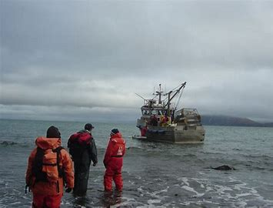
Conclusion
Selandang Ayu first experience supervising a large work crew outside the military
Inexperience and a lack of resources led to significant challenges managing personnel
Many lessons learned from the experience
“Armed with what I have learned in this course, I look forward to future challenges, and would be very much enjoy this type of management job in the future”
All photos courtesy of the United States Coast Guard.
Notes:
Looking back on this job, I realize now that I walked into it woefully unprepared to supervise a crew of seven culturally and professionally diverse individuals. The company literally threw me into a remote situation with little preparation or support. I learned very quickly to think on my feet and work with what I had on hand. Having learned what I have in this class, I feel I could take on a similar situation with much more confidence in my abilities to lead and manage. Thank you for attending my presentation. Have a wonderful day and I look forward to seeing you all during the next class.

